Slide 1

Azure Migration Strategy
Zantac

Slide 2
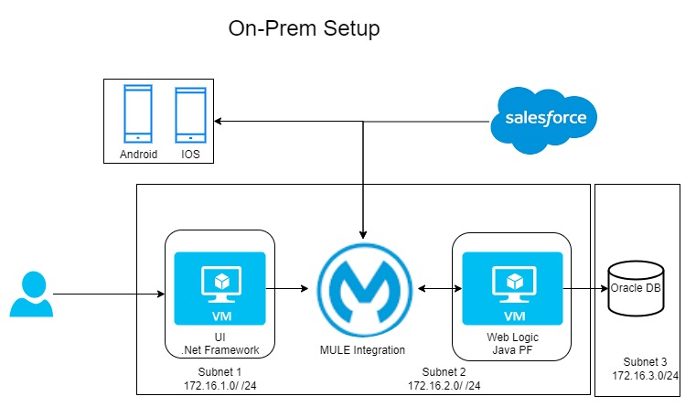
Existing Architecture

Slide 3
Current Challenges
Poor Page loads
Increased Operational cost with the same customer base
Time to Market
Manual to deploy and provisioning the infra

Slide 4
Objectives
Increase Page Loads
Streamline the integrations
On demand Scaling
99.99% Availability
Data retention

Slide 5
KPI
Double the Customer base in next 3 years (1 to 2 Million users)
Expand the business US to Europe
Reduced the Man power
One Click deployments
Page load should be less than a second with 10 K concurrent users

Slide 6
Options
ReHost (Lift and Shift)
Refactor
ReArchitect
ReBuilt

Slide 7
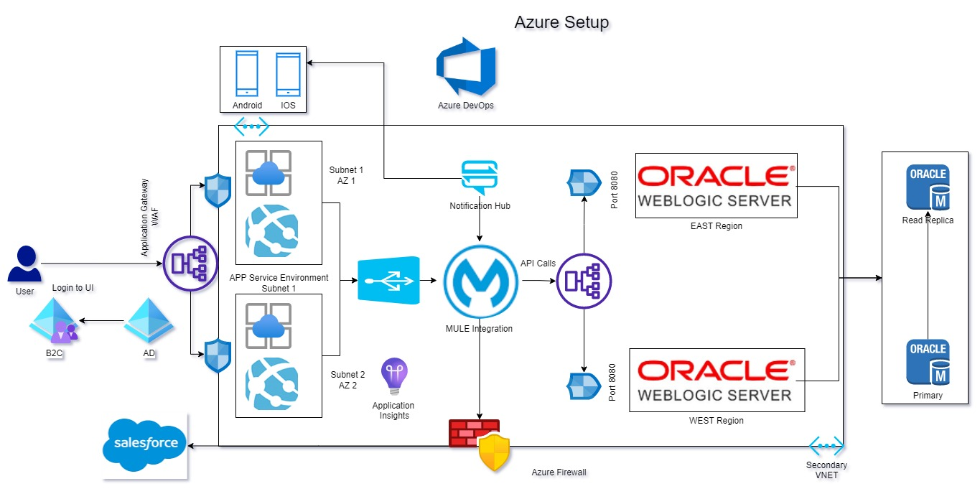
Hybrid Proposed

Slide 8
Migration Road Map
Readiness – Environment readiness, trainings, Access privileges – 15 days
Plan – Identify the Resources and dependencies, SLA’s, POC, Rearchitect the proposal if required AND Migration Planning. 30 days
Provisioning – Built the environment – 30 days
Testing – End to End testing. – 1 week
Migration – Redirect the traffic to Cloud environment – 1 hour
Monitoring – Setup the Monitoring and Alerting, incase of any issues go back to old env.

Slide 9
Thank you

